Slide 1
HTML & CSS Overview
CTEC 130

Slide 2
The Technology

Slide 3
HTML, CSS and Javascript
HTML - HyperText Markup Language
Provides the content of the web
Not technically a “programming” language since it’s not interactive, but it’s still code
CSS - Cascading Style Sheets
Provides the visual design for HTML pages
Helps to keep content separate from design
Javascript - aka ECMAScript
The open standard scripting language of the web
Used to provide interactivity to web sites
When most people talk about building something interactive in “HTML5,” they’re really talking about writing a bunch of Javascript and maybe using an HTML5 <canvas> element
WASM - Web Assembly
Allows the deployment of different languages to the client-side browser

Slide 4
How Websites are Delivered
Servers on the internet receive requests over the HTTP protocol and reply with HTML, CSS and other resources
Static Site - A server holds and delivers pre-built HTML, CSS and Javascript
Servers running static sites can be very small and efficient, as their task isn’t very difficult
Managing large static sites is a huge pain for the people who have to make updates
Dynamic Site - A server contains scripts or programs to generate HTML, CSS and Javascript on-demand
Servers running dynamic sites must be more powerful, as they technically need to build each HTML page for each user request
Since the server is doing the work of building each page, maintaining a Dynamic Site can be easier

Slide 5
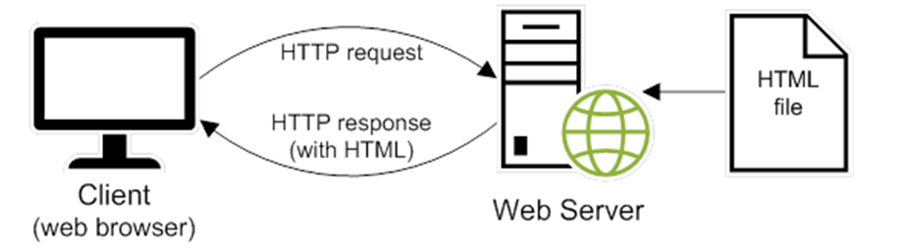
Static Page Server

Slide 6
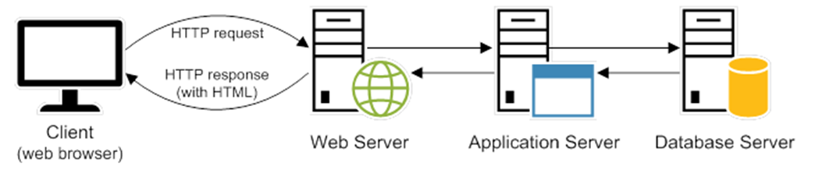
Dynamic Page Server

Slide 7

Dynamic Site Management
Wordpress
Joomla
Custom CMS (Content Management Systems)

Slide 8
Other Server-Side Languages
C# and Visual Basic (ASP.NET)
Ruby (on Rails)
Python (Django and Flask)
Javascript (yep, it’s also Server-Side now, Node)
PHP (Wordpress, Laravel)
Pretty much any other programming language if you’re willing to do the work

Slide 9
So wait, why are we learning this?
Static Sites can still be preferred in many situations
“Serverless” tools like Amazon’s S3 make them incredibly cheap to run
Some sites don’t have to change that much
Restaurant and Business Pages
Small Portfolios
SPAs (Single Page Applications)
Dynamic Sites require you to know HTML and CSS to get the most out of them
Wordpress will do pretty much everything for you, but will also do it awkwardly
Knowing HTML and CSS gives you more power over something like Wordpress
Knowing HTML and CSS is basically required for building a custom CMS of your own
If you’re not building something like Amazon or Twitter and someone knowledgeable is around to make edits, Static can be preferred.

Slide 10
HTML

Slide 11
HTML Syntax
Made up of Elements and Attributes
<p></p>
<p> is an element
Elements (usually) have opening and closing tags
<p> opening
</p> closing
Content and other Elements are placed between opening and closing tags
<p>This is the content of a paragraph</p>
<p>This is a paragraph with <em>emphasis</em> on a word</p>

Slide 12
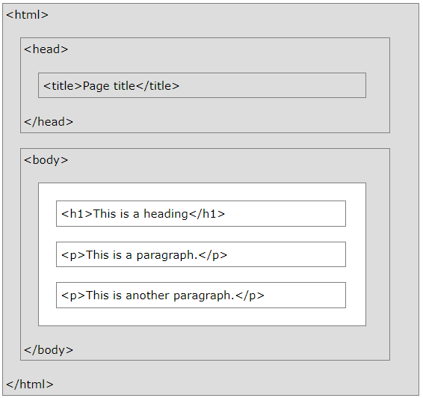
HTML Page Structure
<html>
<head>
<title>
<body>
Visible content

Slide 13
A Few HTML Tags to Start
<!DOCTYPE html> - put at the top of your page, tells the browser what syntax the document is
<html> - root element of the page
<head> - contains metadata about the page
<title> - specifies a title for the page, included at the top of the browser window
<body> - contains all the visible elements of the page
<h1> - “header 1,” the top-most level header (headline) for a page
<p> - paragraph, holds a single paragraph of text
<br> - a line break
Doesn’t have an end tag (but using <br/> instead doesn’t hurt)
<p> This is a proper use of <br> right here</p>

Slide 14
More HTML Syntax Details
Whitespace - generally ignored
Comments:
<!-- this is a comment –>
Aren’t visible in the document, stay in the source
End Tags
Should always be used
Browsers can usually guess where they go if they’re missing, but this is very poor practice
Some tags are self-closing
Instead of having an opening and closing tag, you have a single tag that ends with />
Case Sensitivity
HTML is not case sensitive, but it’s recommended to use lower-case in your tags

Slide 15
HTML Attributes
Elements can have Attributes
Extra details included within the <> of an opening tag
Come in name/value pairs like: name=”value”
Used for extra features we’ll describe later
Some Early Examples:
<a> - “Anchor,” allows you to specify a link
<a href=”https://www.google.com”>A Google Link</a>
href - the site you want to link to
<img> - Image, allows you to add an image
<img src=”moose.jpg” alt=”A Moose Picture” >
src - the location of the image you want to display
alt - text that describes the image for accessibility purposes

Slide 16
CSS

Slide 17
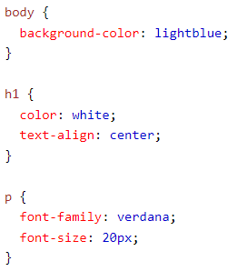
CSS Syntax
Selectors
define what you’re styling
The body, h1 and p in the right example
Declarations
lines of styling rules separated by ;
Made up of Property:Value;
Contained within {}
Each block of {} can have multiple declarations

Slide 18
Separation of Content and Style
HTML should contain only content, not style
CSS should contain information on style
http://www.csszengarden.com/

Slide 19
Editors

Slide 20
Text Editing
Any plain text-editor can be used to write HTML and CSS
But some programs offer nice features
Some Recommended Text Editors:
Visual Studio Code (my choice for most languages)
Brackets (an HTML/CSS focused editor)
Sublime Text
Atom
Notepad++ (if you’re old-school)

Slide 21
Working with Files

Slide 22
Let’s Make a Web Page

Slide 23
Other Tools

Slide 24
The End of the Browser Wars
Browser Interoperability was terrible through the 90’s and 2000’s
Microsoft recently gave up
Their newest version of Edge runs on Chromium, the open-source project behind Google’s Chrome
Even though modern browsers are better, older browsers are still in use
Even though things are better, web developers still need to watch for cross-browser issues, especially when targeting older browsers
https://caniuse.com/

Slide 25
Validation
Browsers are very permissive of errors
Missing end-tags, spelling errors in tags and attributes, missing syntax may all be “fixed” by the browser when the page displays
This isn’t really what we want, as we want full control over how the page displays
https://validator.w3.org/
Checks your html and lets you know what syntax errors may exist
“Logic” problems are up to you to notice and fix

Slide 26
Viewing Site Code
You can view the HTML code of any site on the internet
This may get you sued by the Missouri government for hacking
Right Click -> View Page Source
Right Click -> Inspect

Slide 27
Putting Aside the Jetpack
Writing HTML and CSS can be time-consuming and difficult to troubleshoot
Tools exist to speed-up web development
WebFlow, Wix, SquareSpace - online HTML/CSS development tool and hosting site
Bootstrap, Bulma, Tailwind - CSS libraries that provide basic styles
Don’t use them (yet).
Learning HTML and CSS is a Mountain, these tools are a Jetpack
If the jetpack breaks down and you don’t know mountain-climbing, you’re in trouble

Slide 28
Accessibility

Slide 29
Think Accessibility From the Beginning
Not everyone experiences the web like you do
Tools are available for those with
Visual Impairments
Hearing Impairments
Mobility Impairments
Cognitive Impairments
For those tools to work best, your site must be built with accessibility in mind
Add alt text to non-decorative images
HTML content is in a sensible order when not styled
HTML semantic tags are properly used
Many other things that we’ll cover as we reach them
It’s the right thing to do, and it’ll keep you from getting sued

Slide 30
Other Issues

Slide 31
Other Issues
SEO
Cross-Browser Compatibility
Responsive Design

